Slide 1


MINING THE SKY,
SELLING IN THE ORBIT
ANTLIA
1998
Turning near-earth asteroid water into affordable rocket propellant
ORION
1998

Slide 2
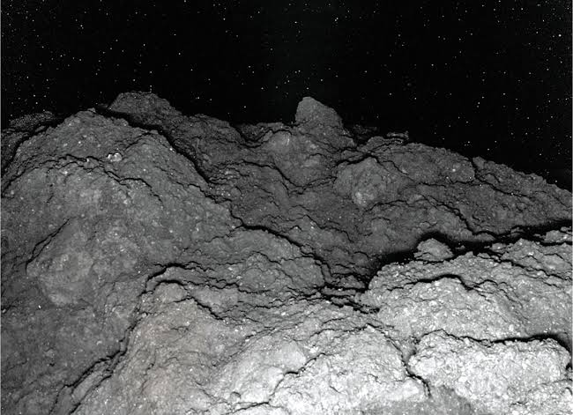
BUILDING THE MINING ARCHITECTURE
TARGET CLASS-Easily recoverable C-Type Near Earth Asteroids.
Why?
Lower Δv than the lunar surface-The C-Type near earth asteroids have a Δv lower than that of lunar surface. Thus making it more accessible than main-belt asteroids.
Less one-way transit time-It takes around 6-18 months to reach near earth asteroids. Fast trip ensures constant cash flow and spares our machinery from long-term machinery soak.
Full solar muscle-Operating near 1AU guarantees ~1.36kw/m^2. Of raw solar flux. Which can be utilised using thin ultraviolet films instead of multi-ton power plants on earth.
T
0

Slide 3

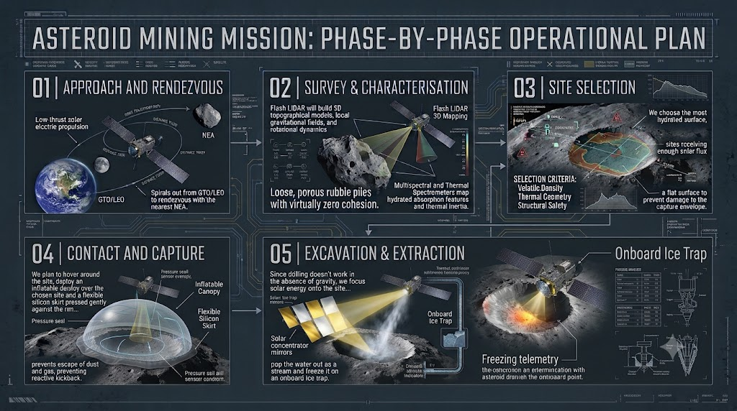
T
2

Slide 4
MAKING THE RUN PROFITABLE: IDENTIFYING THE COST DRIVERS
LAUNCH MASS PENALTY
GROUND SUPPORT & R&D
SAFETY & REGULATORY
Launching massive, rigid hardware increases CapEx massively.
Cost Reduction Strategy:
01. Cut Δv with smarter trajectories.
02. Highly specific power solar-arrays.
03. Integrated & miniaturized avionics.
Traditional missions require a lot of ground support and capital for R&D.
Cost Reduction Strategy:
01. Lean towards cloud-based research platforms.
02. Leverage contacts from established space organizations.
Third party liability insurance consumes 15–25% of mission CapEx for space debris damage risks.
Cost Reduction Strategy:
01. Ensure zero orbital debris with 100% containment.
T
2

Slide 5

CUSTOMERS, PRICING AND MARKET REALITY
PRIMARY RESOURCE
Water and Hydrated resources:
01. Rocket Propellant & Life Support
Water can be used as a rocket propellant and life support for crew in outer space.
02. Radiation Shielding
Water and silicates can be used in radiation shielding.
03. Space Metallurgy
Source of magnesium and silicon for metallurgy in space matures.
OTHER OPTIONS
Carbon, Nitrogen and other organic substances:
01. Hydrocarbon Fuels
In space hydrocarbon fuels.
02. Carbon Polymers
In space manufacture of carbon polymers.
T
3
TARGET BASE:
People in orbital economy

Slide 6
Starship and Blue Moon launch multiple tanker flights just to refill a single lander in orbit.
Buying propellant from us would reduce their mission complexity and launch count.
WHERE WILL THE RESOURCE BE SOLD?
The idea is not of selling water,it is the selling of avoided launch costs
T
4
DEEP SPACE TRANSPORT OPERATORS
COMMERCIAL SPACE STATIONS AND LEO INDUSTRIAL PLATFORMS
The cislunar transit market requires 150 to 300 metric tonnes of propellant per year
Commercial habitats require continuous supply of water and orbit-boosting propellant to combat atmospheric drag.

Slide 7
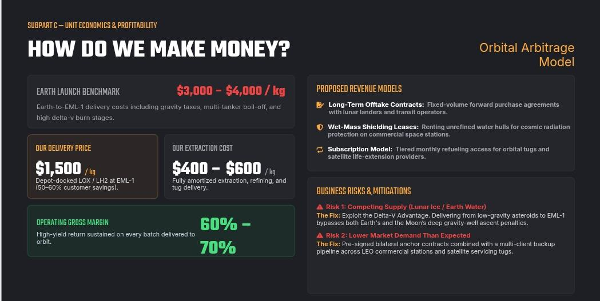

Slide 8


THANKS
T
0

